Slide 1

HEMWATI NANDAN BAHUGUNA GARHWAL UNIVERSITY
(A CENTRAL UNIVERSITY)
“FARECAST: INTELLIGENT TAXI FARE PREDICTION USING MACHINE LEARNING”
GUIDED BY :
PRESENTED BY :
DR. OM PRAKASH
ASSISTANT PROFESSOR
COMPUTER SCIENCE & ENGINEERING
ABHINAV AGARWAL (20134501011)
ARSHAD KHAN (20134501018)
SHAKTI SINGH (20134501035)

Slide 2
Table Of Content
INTRODUCTION
PROBLEM STATEMENT
SOLUTION
DATABASE TABLE
MODEL USED
WORKING MODEL
LANDING PAGE
LOGIN PAGE
REGISTRATION PAGE
FARE FORM PAGE
FARE PREDICTION PAGE
CONCLUSION
REFERENCES

Slide 3
INTRODUCTION
In the era of urbanization and technological advancements, transportation systems play a pivotal role in shaping the dynamics of modern cities. Taxis, as one of the most ubiquitous modes of public transportation, serve as lifelines connecting commuters to their destinations swiftly and conveniently.
This project aims to tackle this issue by leveraging the power of data science to predict taxi fares accurately. By analyzing historical taxi ride data, we seek to develop a predictive model that can estimate fares based on various factors such as pickup and drop-off locations, time of day, distance traveled, and other relevant features.
The project will follow a systematic approach, encompassing data collection, preprocessing, feature engineering, model selection, training, evaluation, and deployment phases. We will explore various machine learning algorithms and techniques to develop a robust predictive model that generalizes well to unseen data.

Slide 4
PROBLEM STATMENT
The unpredictable nature of taxi fares poses a challenge for both passengers and service providers in urban transportation systems. Passengers often face uncertainty regarding the cost of their taxi rides, leading to dissatisfaction and inconvenience. On the other hand, taxi service providers struggle to maintain transparent pricing policies while ensuring profitability. The primary aim of this project is to develop a robust predictive model capable of accurately estimating taxi fares based on various input parameters. By leveraging historical taxi ride data, we seek to address the following key objectives:
Accuracy
Transparency
Optimization
Generalization

Slide 5
SOLUTION
To address the challenges outlined in the problem statement, we propose the following solution framework:
Data Collection and Preprocessing :We collected a comprehensive dataset containing historical taxi ride records.
Feature Engineering : We engineered new features to enrich the dataset and enhance the predictive power of our models.
Model Selection and Training :We experimented with various machine learning algorithms, including linear regression, decision trees, random forests, gradient boosting, and neural networks.
Model Evaluation : We evaluated the trained models using appropriate metrics such as Mean Squared Error (MSE), Root Mean Squared Error (RMSE), and Mean Absolute Error (MAE) on the testing dataset.
Deployment and Integration: The final XGBoost model was deployed into a production environment, integrated with a user-facing application.
Monitoring and Maintenance: We implemented monitoring mechanisms to track the performance of the deployed model in real-time.

Slide 6
DATASET TABLE
ATTRIBUTES | DESCRPTION
total_amount | The total amount paid by the traveler for the taxi ride.
VendorID | An identifier for taxi vendors.
tpep_pickup_datetime and tpep_dropoff_datetime | Timestamps indicating pickup and drop-off times.
passenger_count | The number of passengers during the ride.
trip_distance | The distance traveled during the trip.
RatecodeID | Rate code for the ride.
store_and_fwd_flag | A flag indicating whether the trip data was stored and forwarded.
PULocationID and DOLocationID | Pickup and drop-off location identifiers.
payment_type | Payment type used for the ride.
DATABASE LINK : https://research.iitm.ac.in/IITMBSCS2008

Slide 7
MODELS USED
We have implement four model
Linear Regression(R2_Score:0.703)
Decision Tree (R2_Score:0.9432)
Random Forest Regressor(R2_Score:0.9536)
XGB_Regressor (R2_score:0.9527)
Our Final Model is XGB_Regressor which accounts for public score:0.92908

Slide 8
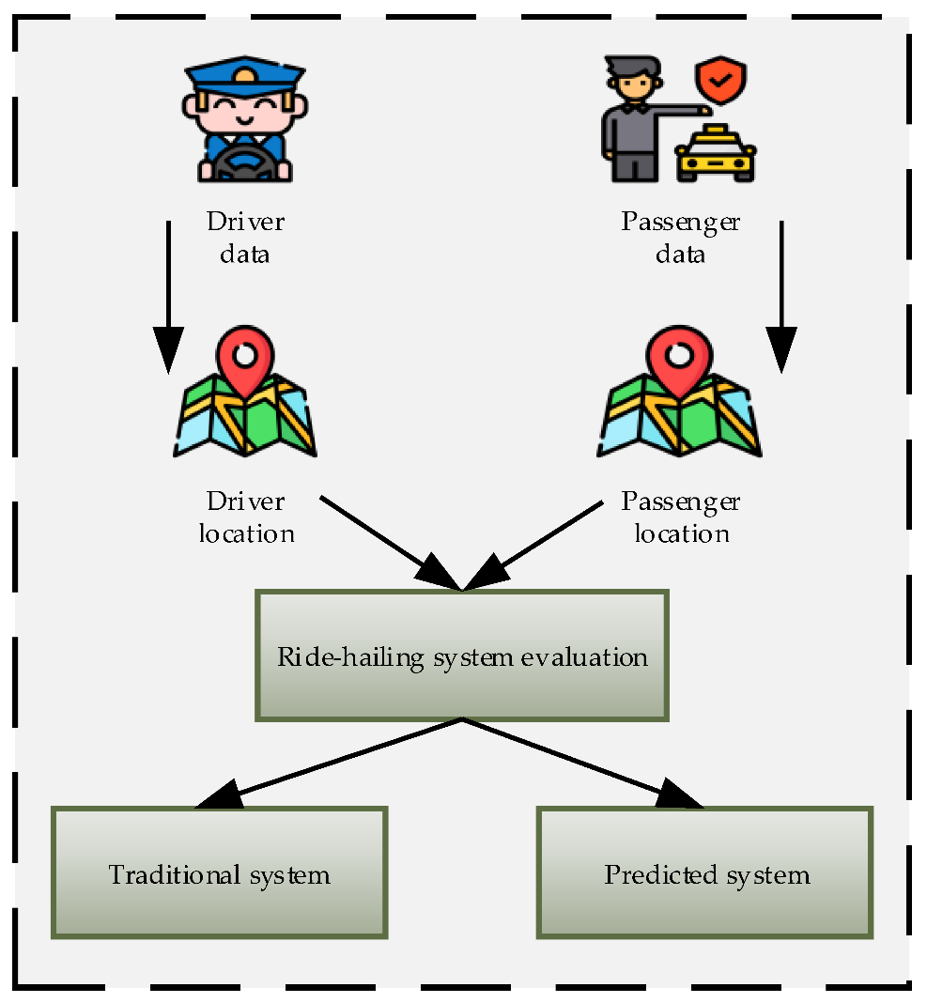
WORKING MODEL

Slide 9
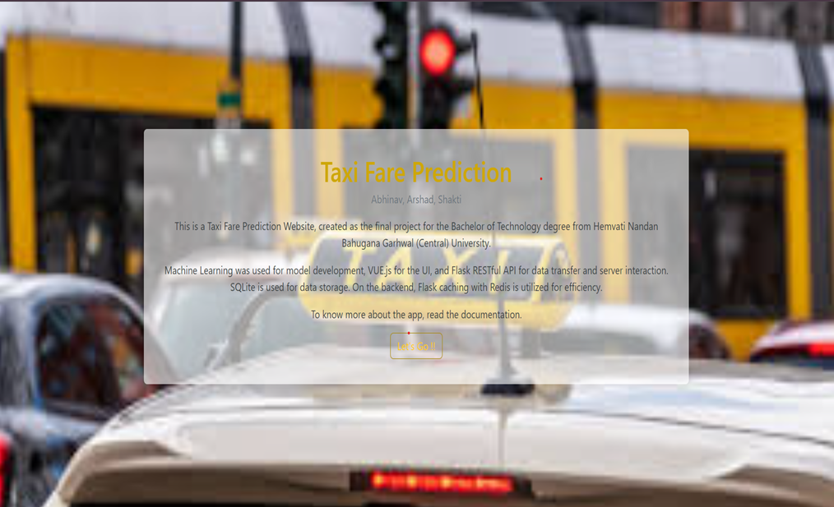
LANDING PAGE

Slide 10
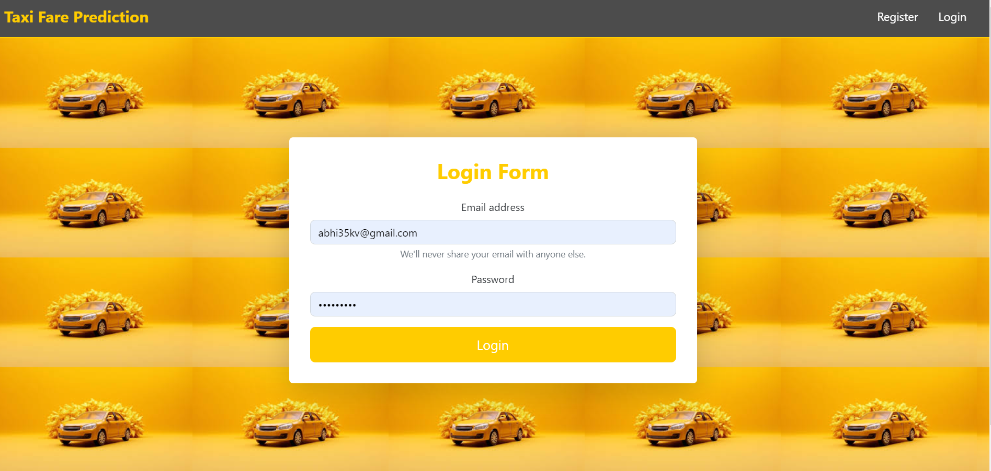
LOGIN PAGE

Slide 11
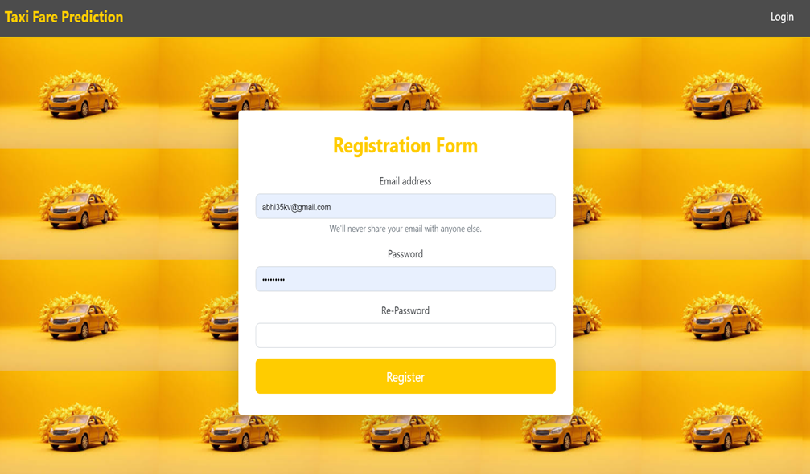
REGISTRATION PAGE

Slide 12
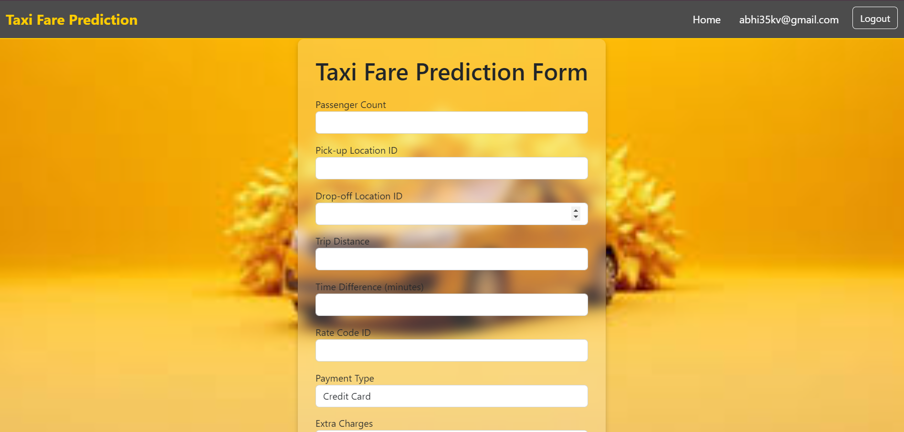
FARE FORM PAGE

Slide 13
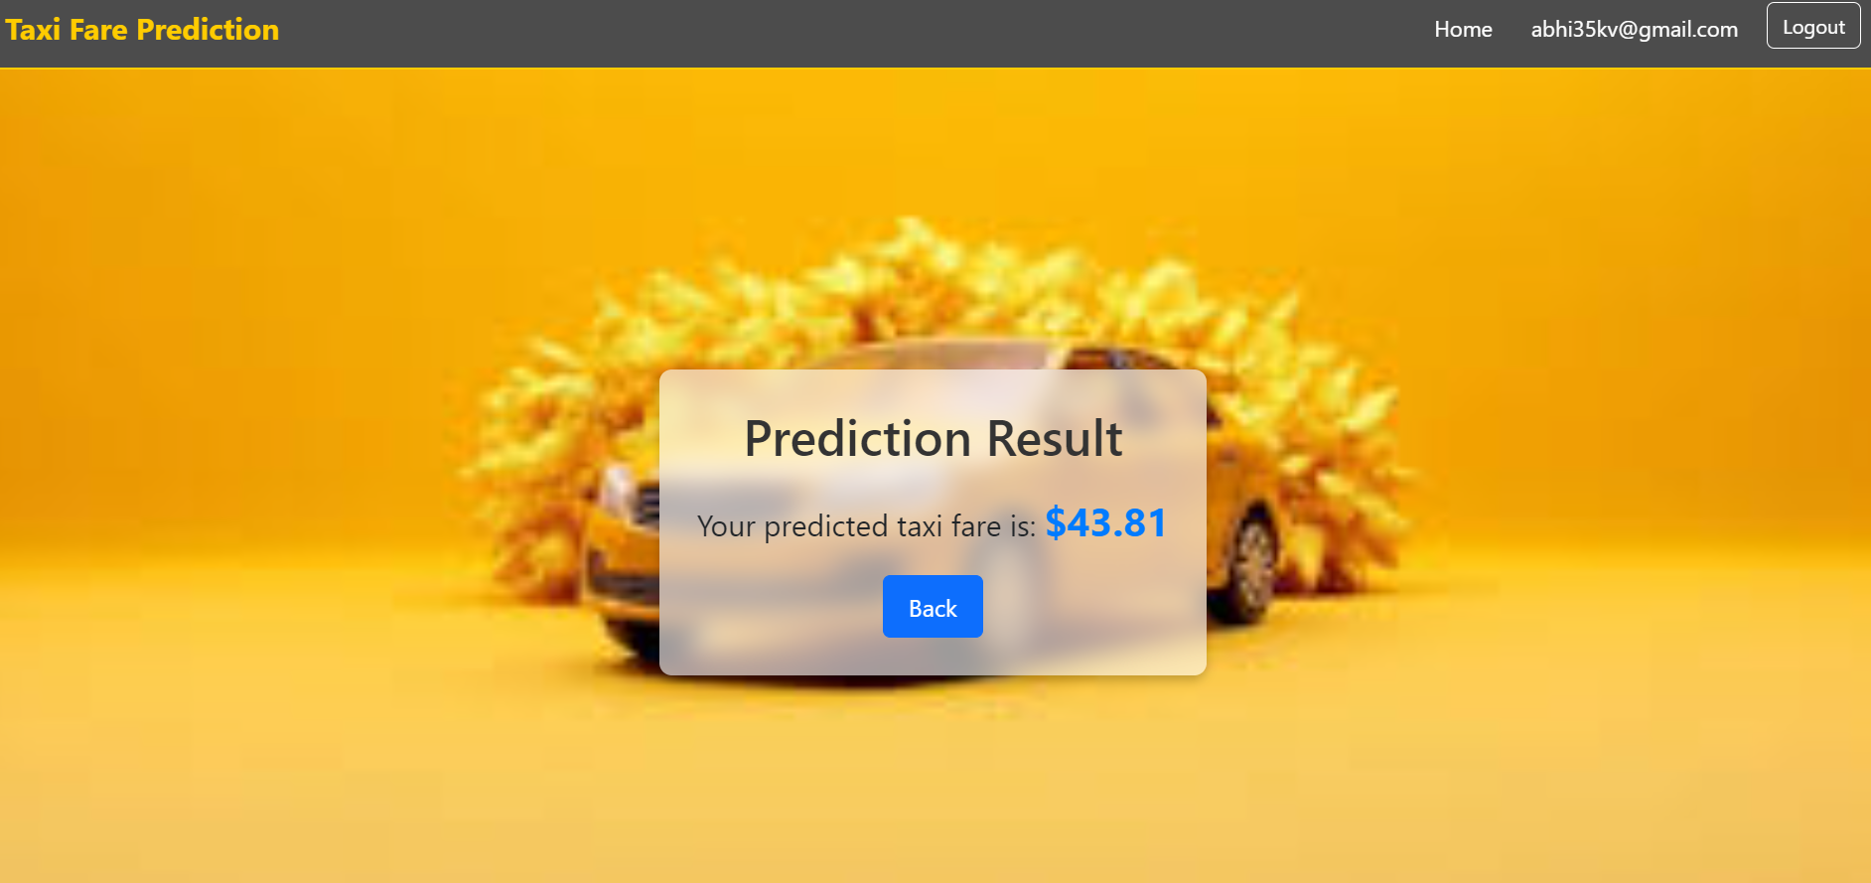
FARE PREDICTION PAGE

Slide 14
CONCLUSION
The taxi fare prediction project has demonstrated the feasibility and effectiveness of leveraging data science techniques to address the challenges associated with estimating taxi fares accurately. Through meticulous data collection, preprocessing, feature engineering, model selection, and deployment, we have developed a robust predictive model capable of providing reliable fare estimates in real-time.
The project has yielded several key insights and contributions:
Improved Transparency
Enhanced User Experience
Optimized Pricing Strategies
Generalization and Robustness
Continuous Improvement

Slide 15
REFERENCES
https://www.geeksforgeeks.org/machine-learning-algorithms/
https://www.ibm.com/topics/machine-learning
https://en.wikipedia.org/wiki/Machine_learning
https://www.theengineeringprojects.com/
https://www.iitmreearch.com/

Slide 16
THANK YOU

